Slide 1

Implementation of Machine Learning Algorithms in C++
Alex Gilsoul

Slide 2
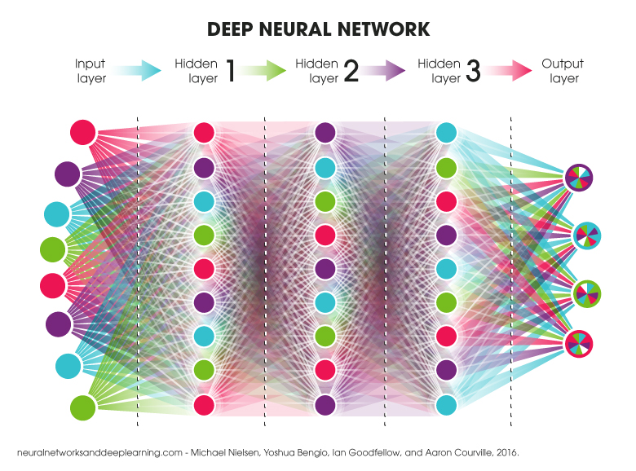
What is Machine Learning?
Machine Learning is the study of predictive computer algorithms that, using large sets of data, improve their predictive accuracy over time.
This can range from regression models that determine the line of best fit for coordinates of data to neural networks being used for speech recognition.
It is what is more commonly known as Artificial Intelligence.
An example of a basic neural network

Slide 3
How Does Machine Learning Work?
The way a machine learning algorithm works largely depends on which algorithm is being used, and what problem is being solved.
Most algorithms require the use of basic-advanced calculus for the adjustment of parameters, also called weights, but some just require advanced geometry (such as taking the distance between points in higher than 3 dimensions).

Slide 4
Implementing Machine Learning Algorithms in Code
Most existing resources and libraries for machine learning algorithms are written for the coding languages Python or R. Very few exist for C++, so that is the language I decided to code my algorithms in.
While Python and R are much easier to use, you can get a lot more specific in C++ with how data is used, and because of that it is the one I spend the most time with and is the one I am most proficient in.

Slide 5
Classroom Foundation for Machine Learning Projects
Programming a machine learning algorithm from scratch is far from simple. It requires extensive knowledge of the coding language you’re programming in and a solid mathematical foundation to work from and build off as you research different algorithms and how they work.
Multiple classes at NUAMES have helped me build up this computer science/math foundation. I had programmed before high school, but I wasn’t formally taught until then. I have taken/am taking multiple Computer Science classes, including CS 1030, CS 1400, CS 1410, CS 2420, CS 2705, and CS 3230, with more to come next semester. I am currently taking Calculus, with trigonometry and all the prerequisites completed as well.
Even with all these classes, the structure and math behind some of the more advanced algorithms remains complicated and confusing, requiring me to learn from outside sources to learn the requisite knowledge.

Slide 6

Algorithm Implementation in C++

Slide 7
Background Information for Algorithm Testing
While direct comparisons cannot be made between all algorithms, where it is applicable, classification algorithms will use the same dataset with a 60:40 training/validation split. This dataset is labeled and will be used for supervised training.
For classification algorithms, there is a lot of reliance on randomly generated numbers. This is unlikely to have a large effect, as random values will tend to converge to ideal values, but it should be noted that it can sometimes affect the testing process.
For regression models, the accuracy and error of the model is relative to the data which it is predicting. An error of 40 relative to an actual value of 10,000 is better when compared to an error of 40 relative to an actual value of 50.

Slide 8

K-Nearest Neighbors

Slide 9
K-Nearest Neighbors (KNN) Classification Algorithm
KNN takes in data points with strictly numeric features, except for a data label. Ex.) Point 1: {5.5, 0.7, “Green”}
The numeric data is then normalized using min-max normalization, to convert all values to fit in the range [0, 1].
The data is split into a training dataset and validation dataset, with the training dataset being stored as a variable in the KNN classifier object.
To classify an unknown data point, the Euclidean distance to each of the training points is calculated. For a 2D plane, the x coordinate of the unknown point is subtracted from the x coordinate of each training point and is then squared. This is then added to the same value for the y coordinates, and then the square root of the total is calculated. This can be represented as: √((x₀-x_{i})² + (y₀-y_{i})²). This may look familiar, because it is the Pythagorean theorem. Rather than distances A and B, the distance is the difference between each x and y. This can be done with any number of dimensions, not just two. This distance is calculated from the unknown point to each training point, and then the training points are sorted based on which points are closest.
Once the list has been sorted, the labels of the “K” nearest points are counted (K is a pre-specified number, it can technically be any number as long as it is less than or equal to the number of training points). Whichever label has the most points classified under it within the “K” nearest points is what the unknown point is classified as.
To test the accuracy of the algorithm, this process is done with every point in the validation dataset, and the accuracy is the number of correct points divided by the total number of points tested.

Slide 10
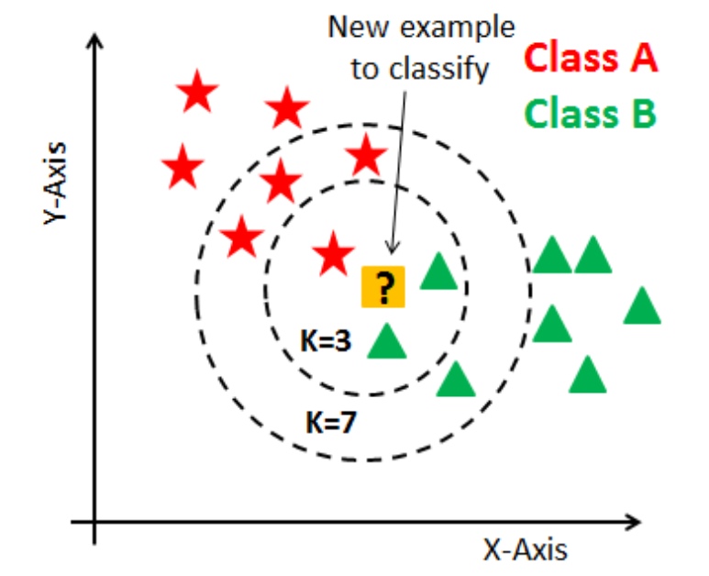
KNN Visualized
https://ai.plainenglish.io/introduction-to-k-nearest-neighbors-knn-algorithm-e8617a448fa8

Slide 11
Pros and Cons of KNN
Pros:
Very accurate with lots of data
Relatively easy to understand
Cons:
Computationally expensive
Runtime to classify unknown points increases with amount of training data
Only works with labeled data
No training period required
Testing period runtime stays constant for different values of k

Slide 12
KNN Classification Algorithm Demonstration
I wrote a basic driver program for the purpose of demonstrating the accuracy and usage of the KNN Classifier on determining malignancy in breast tumors based on a variety of features, such as mean radius and texture.
The program reads from a .csv file containing 569 data samples, each with 30 different data features, classified as either malignant or benign. This data is then normalized using min-max normalization so that each value fits within the range of [0,1].
The data is then split into a training set and a validation set. The training set is stored as a variable in the classifier object, which the classifier will use as a reference for future points. The label of each validation point is then predicted and compared to the actual value, and a percentage of correctly labeled points is returned. With 5 iterations/epochs and a k value of 25, the algorithm was accurate of over 96% of the time.

Slide 13
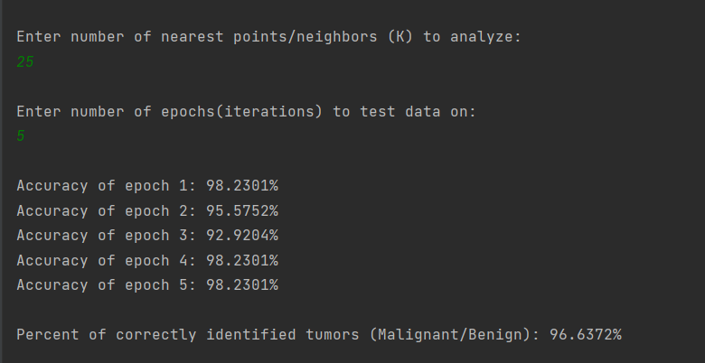

Slide 16

K-Means Clustering

Slide 17
K-Means Clustering (KMC) Classification Algorithm
Similar to KNN but with a few key differences. Rather than comparing an unknown point to other points in the dataset, the point is compared to centroids which are placed in the center of data clusters through a training process.
The number of centroids, k, should be the same as the number of data clusters, which can be determined by experimenting with different values of k.
Whichever centroid a training point is closest to is the centroid that the point is assigned to.
The centroids are then moved to the average location of their assigned points, and then the process of finding the closest centroids to each point starts again.
This process is repeated until the centroids converge (stop moving). When this happens, it is implied that the centroids are in the center of their clusters.
If the data is labelled, then the centroid label for the cluster is determined by whatever label is most common within the cluster.
To identify an unknown point with labelled training data, the centroid which the point is closest to is determined. The point is labeled as whatever the closest centroid is labeled as.

Slide 18

K-Means Clustering Visualized
https://towardsdatascience.com/k-means-a-complete-introduction-1702af9cd8c

Slide 19
Pros and Cons of K-Means Clustering
Pros:
Fairly Accurate
Relatively easy to understand
Cons:
Not as accurate as KNN
Training time scales with amount of data
Not as computationally expensive as KNN, and much quicker
Consistent runtime post-training
Can cluster unlabeled data
Testing time scales with number of centroids/k

Slide 20
K-Means Clustering Classification Algorithm Demonstration
Using the same dataset of breast tumors as used in KNN, I wrote a driver program to train and test my K-Means Clustering code.
The program reads from a .csv file containing 569 data samples, each with 30 different data features, classified as either malignant or benign. This data is then normalized using min-max normalization so that each value fits within the range of [0,1].
The data is then split into a training set and a validation set. The training set is used to center k (in this case 2) centroids in their respective data clusters.
The validation set is used to test the algorithm. The label of each point in the set is predicted, and then compared with the actual value. Through this process, the percent accuracy of the algorithm is determined.
With a k value of 2 being used, the accuracy over ten different iterations was found to be ~85%. This is quite a bit lower than KNN, but the predictions are made magnitudes faster.

Slide 21
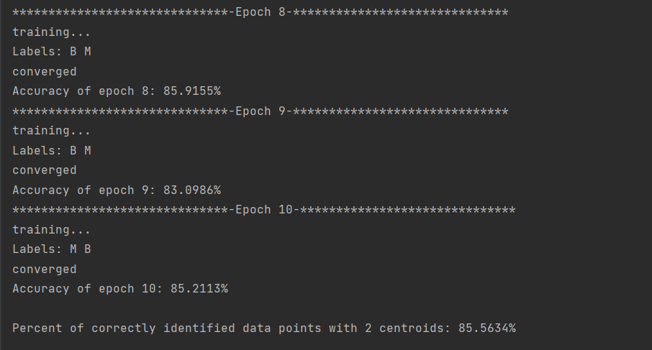

Slide 25

Multiple Linear Regression

Slide 26
Multiple Linear Regression (MLR) Algorithm
Multiple Linear Regression fits a line, plane, or hyperplane (depending on the number of data dimensions) to a set of data.
It is assumed that there is a linear relationship between each data dimension and the output value.
In the case of a dataset with two dimensions (x, y), a line can be fit to it.
A starting line with a coefficient (slope) of 0 and a bias (y-intercept) of 0 is generated.
Using the input variables of a data point, the squared error is calculated. The squared error is determined by taking the difference between the output of the current line and the actual output for the data point. This is done for all data points, and the mean squared error (MSE) is calculated.
The actual MSE is not necessary for the algorithm to work, but the partial derivatives of the MSE function with respect to the coefficients and the bias are. These are calculated and multiplied by a learning rate, with the resulting value being used in a process called gradient descent to calculate the necessary adjustments to each coefficient and the bias. Through this process, the algorithm attempts to reach the absolute minimum of the cost function for each weight.
Once the line’s coefficients and bias stop changing, or converge, training is stopped. At this point, the line is then tested by calculating the MSE of a validation data set.

Slide 27
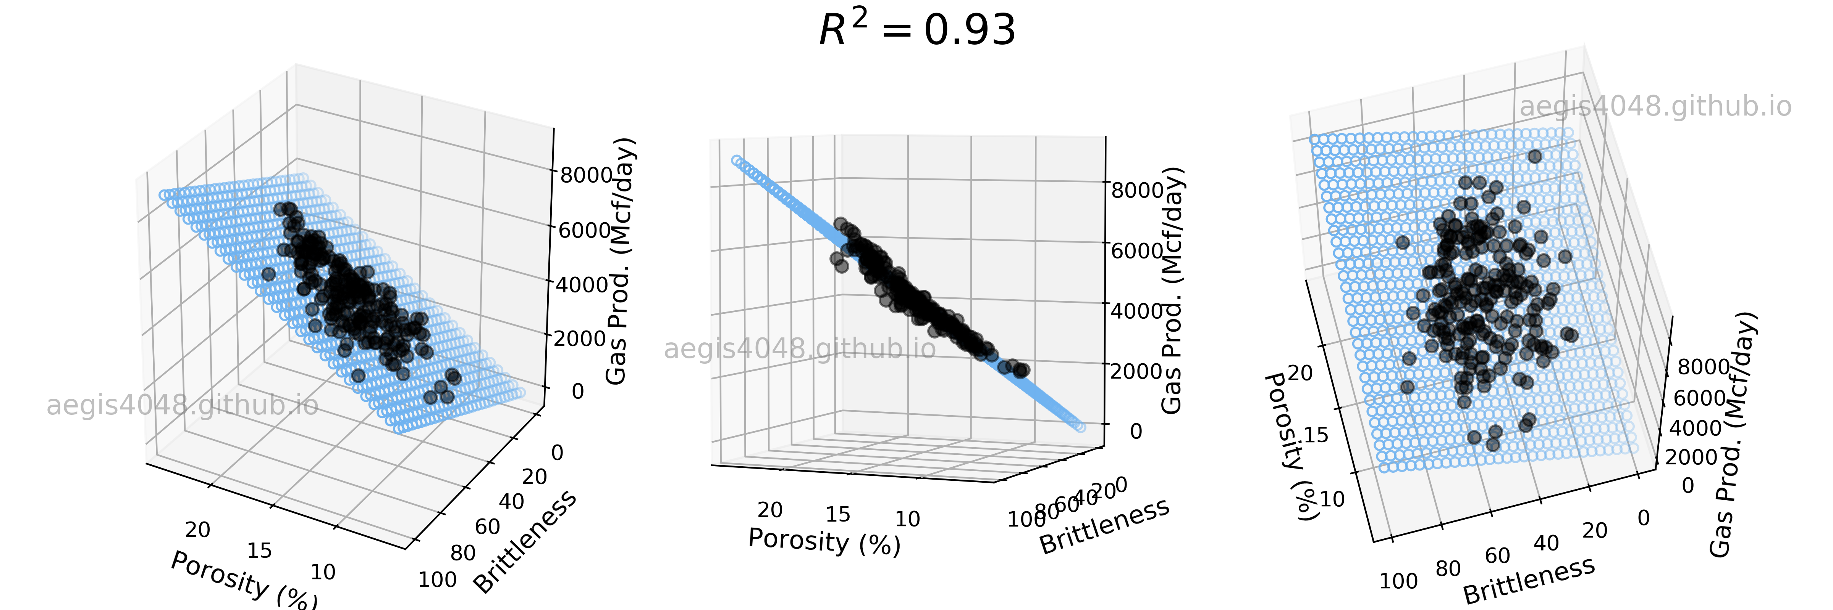
Multiple Linear Regression Visualized
https://aegis4048.github.io/mutiple_linear_regression_and_visualization_in_python

Slide 28
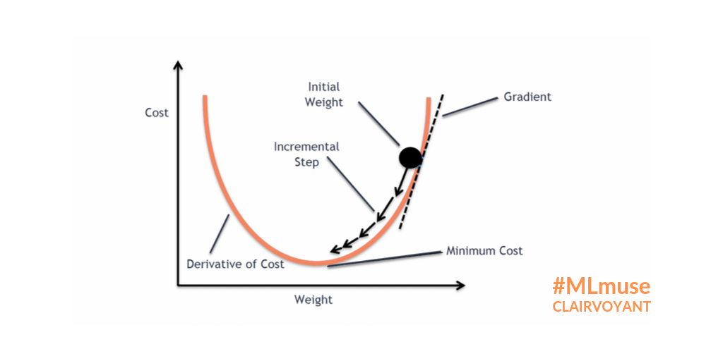
Gradient Descent Visualized
https://blog.clairvoyantsoft.com/the-ascent-of-gradient-descent-23356390836f

Slide 29
Pros and Cons of Multiple Linear Regression
Pros:
Rather than classifying unknown data, MLR can predict outputs with one or more input variables
Cons:
Model accuracy largely depends on how closely correlated the examined data is
Can be very useful for predicting future values
Depending on the amount and type of data, the algorithm can take a short amount of time to converge on coefficient and bias values
Can only reliably predict data with a linear/planar/hyperplanar correlation

Slide 30
Multiple Linear Regression Algorithm Demonstration
To demonstrate the MLR Algorithm, I used an online dataset that contains 24 data points, one for each month over two years. The data includes two input variables, the current month’s interest rate and unemployment rate, and one output variable, the stock index price.
The data is then split into a training set and a validation set.
The model is trained with gradient descent using the training set over a specified number of iterations, or until the model converges. For the purpose of this demonstration, the model is trained over 1000 iterations, which only takes a few seconds.
The model is then tested using the validation set, and achieves an MSE as low as 6500, resulting in a mean error of around 80. This is relative to values that range from around 700 to 1100.

Slide 31
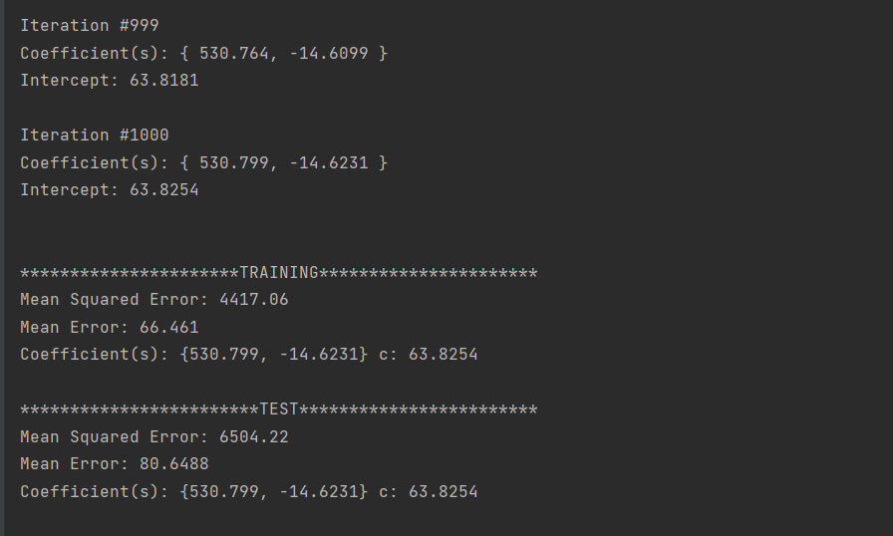

Slide 32
Multiple Linear Regression Algorithm Demonstration Pt. 2
The second dataset being used is one made specifically for linear regression, as the points are relatively tightly packed, while somewhat spread out. The data is pre-split into a training and validation set. In total, there are exactly 100 data points. 798 are used for training, and 202 are used for validation.
The model is again trained with gradient descent using the training set over a specified number of iterations, or until the model converges. For the purpose of this demonstration, the model is trained over 50000 iterations, which takes about one minute.
The model is then tested using the validation set, and achieves an MSE as low as 8.8, resulting in a mean error of around 2.98, with the original y-values ranging from 0 – 100.

Slide 33
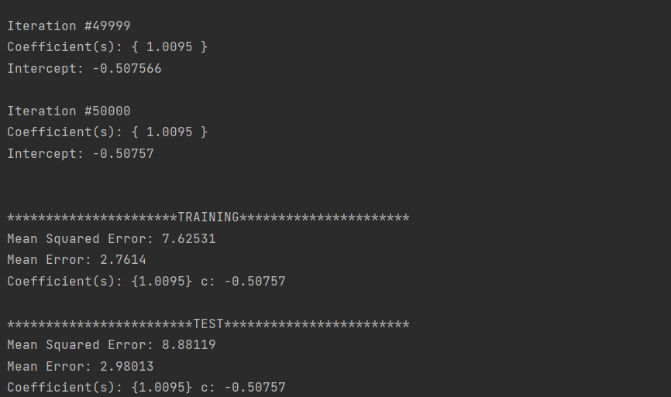

Slide 35

Neural Networks

Slide 36
DISCLAIMER
The complete math behind a neural network is too complex to be explained in just a few slides, so for the sake of the presentation it is simplified.
The math is explained further in the actual code with comments, a link to which is at the end of this presentation.

Slide 37
Artificial Neural Network (NN) Algorithm: Forward Propagation
Artificial Neural Networks use layers of interconnected neurons to predict an algorithm using forward propagation.
NNs consist of an input layer, hidden layer(s), and an output layer.
The number of hidden layers can vary, and the number of neurons in each layer can be specified to any positive integer, apart from the input layer, which is determined by the number of data features.
Forward propagation is the process by which the outputs of one layer are passed onto the next.
Each neuron in one layer passes its output to every output in the next layer.
This repeats until the output layer has calculated its output.
Neuron output is calculated by multiplying the output of each of the neurons in the previous layer by a weight specific to each of those neurons, adding them up, and then adding a bias.
Each neuron has randomly calculated weights for each of the neurons in the previous layer
The output of the neuron is then put through an activation function, such as sigmoid or ReLu, and then passed on to the next layer.
Once the output layer has been reached, its result is then interpreted and used for predicting the values of unknown data, which can be in the context of regression or classification.

Slide 38
Artificial Neural Network (NN) Algorithm: Back Propagation
Back propagation is the process through which a neural network updates and adjusts the weights and biases of each neuron and their connections using gradient descent, similarly to linear regression.
The result of the neural network is compared to the actual result of the data it was trying to predict, and a delta for each of the neurons is calculated.
In the case of the neural network I programmed, each of the output neurons uses the sigmoid activation function, so to update the weights, the derivative of the sigmoid function at the output of the neuron is multiplied by the difference between the output of the neuron and the actual result of the data. This value is saved to the neuron as its “delta”. This delta is then multiplied by each of the each of the previous inputs for each weight, and then multiplied by the learning rate of the algorithm (a pre-specified number). The resultant number, known as the gradient, is then subtracted from the current weight’s value to adjust the weight. A similar process is used for the adjustment of each neuron’s bias.
For hidden layers, the process is similar, but rather than using the difference between the network’s expected output, it uses the deltas for each of the neurons in the next layer. In addition to this, a different activation function is used. Rather than sigmoid, each neuron uses the ReLu function. I have found the use of ReLu in the hidden layers to work much better than sigmoid, but sigmoid works better for computing outputs in the output layer.
In my NN, a concept called momentum is used. In momentum, you have a pre-specified value, which is then multiplied by the previous gradient is added to the current gradient to update the current weight. This quickens the training process by encouraging gradient descent in a continuous direction. If the gradient keeps decreasing, momentum will increase the rate at which it decreases. This can lead to overshooting in some cases, but the gradient should stabilize eventually.

Slide 39
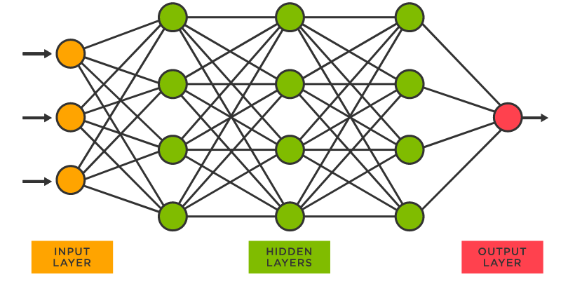
Neural Networks Visualized
https://www.tibco.com/reference-center/what-is-a-neural-network

Slide 40
Pros and Cons of Neural Networks
Pros:
NNs can be used for both regression and classification
Cons:
If there is a high volume of training data or if the training data itself has a lot of data features, training can take a very long time
Training is very computationally expensive. For example, if you have a neural network with 4 layers, the first with 5 neurons, the second with 10 neurons, the third with 10 neurons, and the fourth with 8 neurons, for each run of back propagation 4,000 weights are updated, and this is done for each training point
Extremely quick at predicting unknown data
Can constantly be trained further, with its accuracy increasing with the more data it gets

Slide 41
Artificial Neural Network Demonstration
To display the relative accuracy and runtime of the neural network when compared to other algorithms, I used the same breast tumor dataset used by KNN and KMC using a 60:40 training/validation split.
I created a network with 1 hidden layer, a learning rate of 0.01, and a momentum of 0.9. The hidden layer has 60 neurons, and the output layer has two, since the network is being used as a binary classifier. Since the input layer neuron count is dictated by the number of data features, it has 30 neurons.
The network is trained using back propagation for each training data point, and trains with the training dataset over 100 iterations, which takes around 30 seconds.
The model is then tested using the validation set. This is done extremely quickly, and the percent of tumors correctly identified is typically in the high 90s, but the network can sometimes reach 100%. The accuracy varies, as the weights are randomly initialized for each test to get an average.

Slide 42
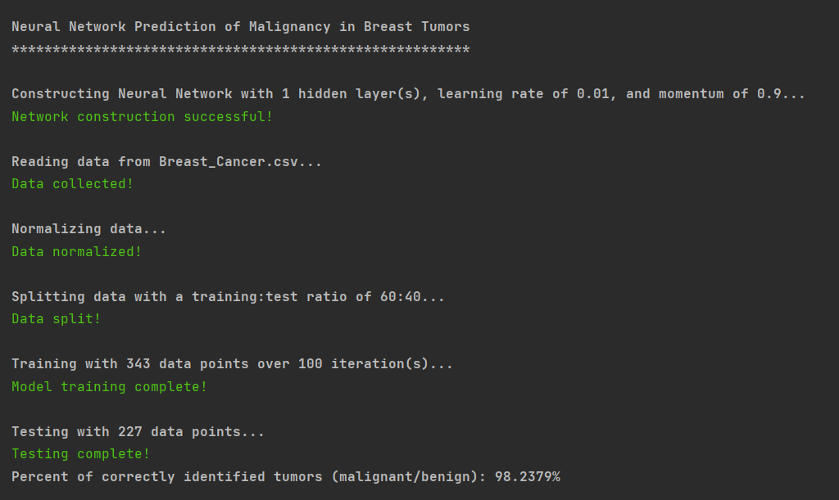

Slide 43
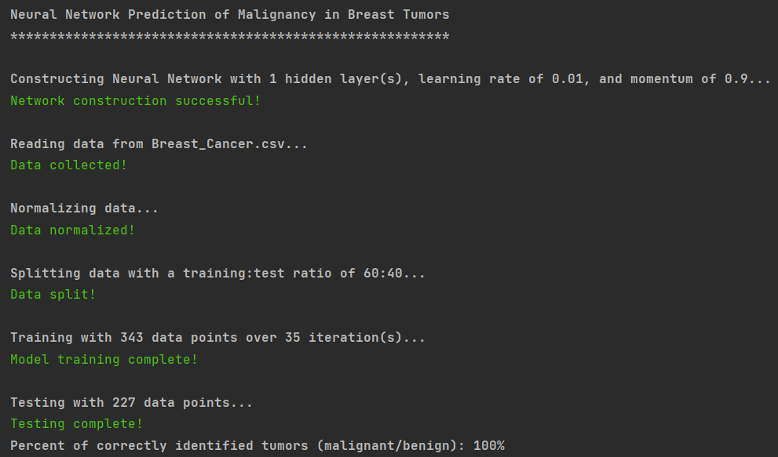

Slide 46
Conclusions and Key Takeaways
The algorithms I have written are nothing new or revolutionary. The ideas have been put into practice before, but I believe what makes mine different is that every algorithm is made purely from scratch. No dedicated machine learning libraries were used, so I had to write every method myself. If I ever actually needed to use one of the algorithms, then I would probably use a machine learning library, but the focus of this project was not future-usability. The purpose was to research and implement machine learning algorithms in C++ and doing so required me learning the fundamentals of each algorithm. Without knowing the basis upon which an algorithm is written, you can’t improve on it. My capstone has allowed me to pour a foundation of knowledge and experience upon which I can build off in the future.

Slide 47
Citations and Links
Link to GitHub Repository (contains the code for each algorithm)
https://github.com/AGilsoul/GilsoulCapstone
Resources used for learning purposes
https://www.codecademy.com/learn/machine-learning
https://towardsdatascience.com/linear-regression-using-gradient-descent-97a6c8700931
https://towardsdatascience.com/k-means-a-complete-introduction-1702af9cd8c
Datasets:
Breast Cancer Wisconsin (Diagnostic) Data Set
https://archive.ics.uci.edu/ml/datasets/breast+cancer+wisconsin+(diagnostic)
Unnamed Stock Index Price MLR Data Set
https://datatofish.com/multiple-linear-regression-python/

